Slide 1
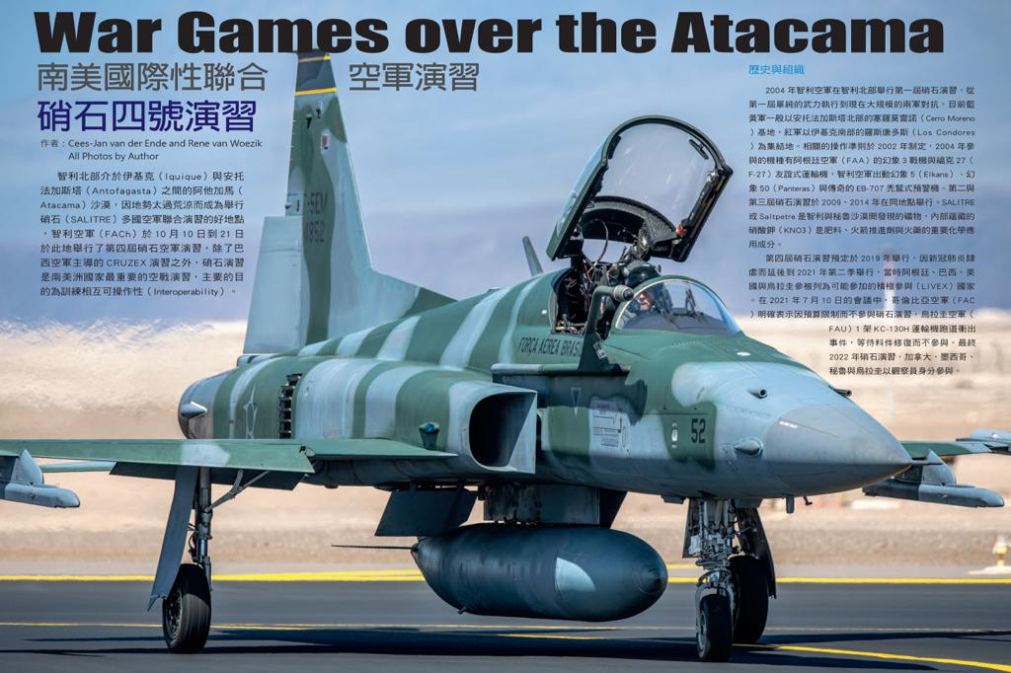
Taiwanese Magazine Defence Internatonial
Taiwanese magazine Defence Internatonial

Slide 2
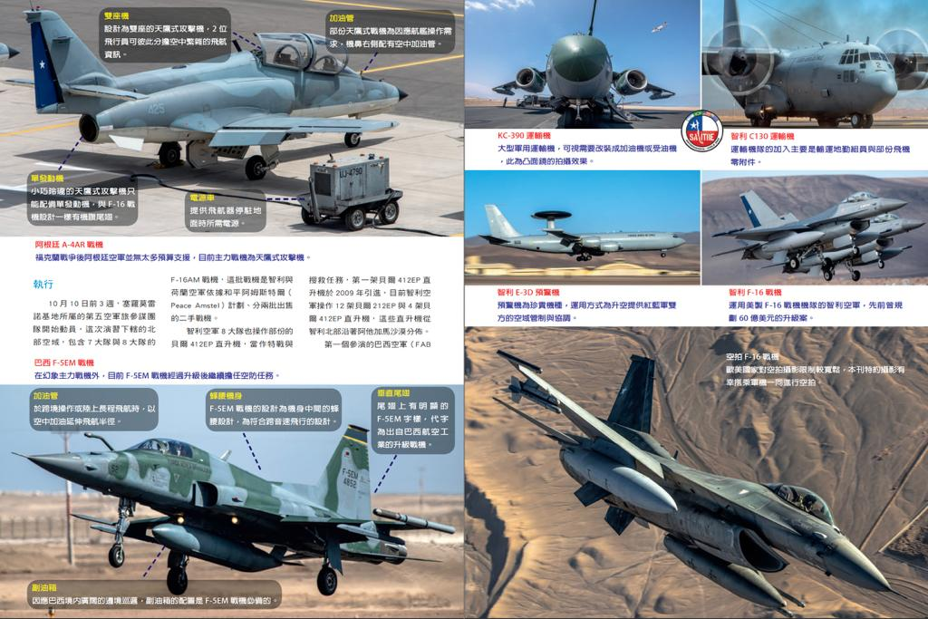

Slide 3
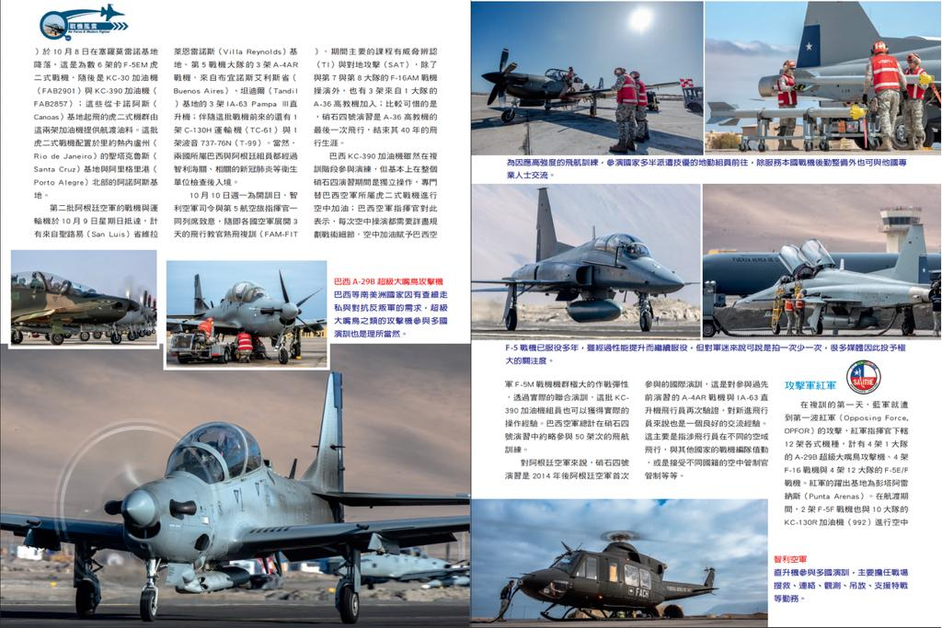

Slide 4
